Slide 1
DATATHON 2023
Relation between federal funding and DEIA factors
Team Marymount

Slide 2
Table of Contents
Research Question
Hypothesis
Data Exploration
Conclusion
Alternative analysis
Data exploration
Conclusion

Slide 3
Members:
Himadri Bhandari: B.Sc. in Information Technology and Economics with a minor in Applied Statistics
Sneha Joshi: B.Sc. in Computer Science with minor in Data Science
Meharban Arora: B.Sc. in Information Technology and Economics with a minor in Applied Statistics
Manuel Gaunaurd: B.Sc. Economics with minors in Finance and Applied Statistics
Tsiorisoa Rakotondrabe: B.Sc. Economics with minors in Finance and Applied Statistics

Slide 4
Research Question
How is graduation rates being affected by federal funds, number of patents (and other innovation indicators), and unemployment rates categorized by state considering the racial differences within each state?

Slide 5
Hypothesis
As unemployed people per state increase (+) | Graduation rates decrease (-)
As patents awarded in S&E/1000 individuals increase (+) | Graduation rates increase (+)
As R&D Obligations in S&E increase (+) | Graduation rates increase (+)
S&E: Science and Engineering
R&D: Research and Development

Slide 6
Demographics analysis per state
We analyzed the demographics per state to see how the distribution lies in each state, the following link has all the visualizations for each state from 2008 - 2019:
Demographics Per State

Slide 7
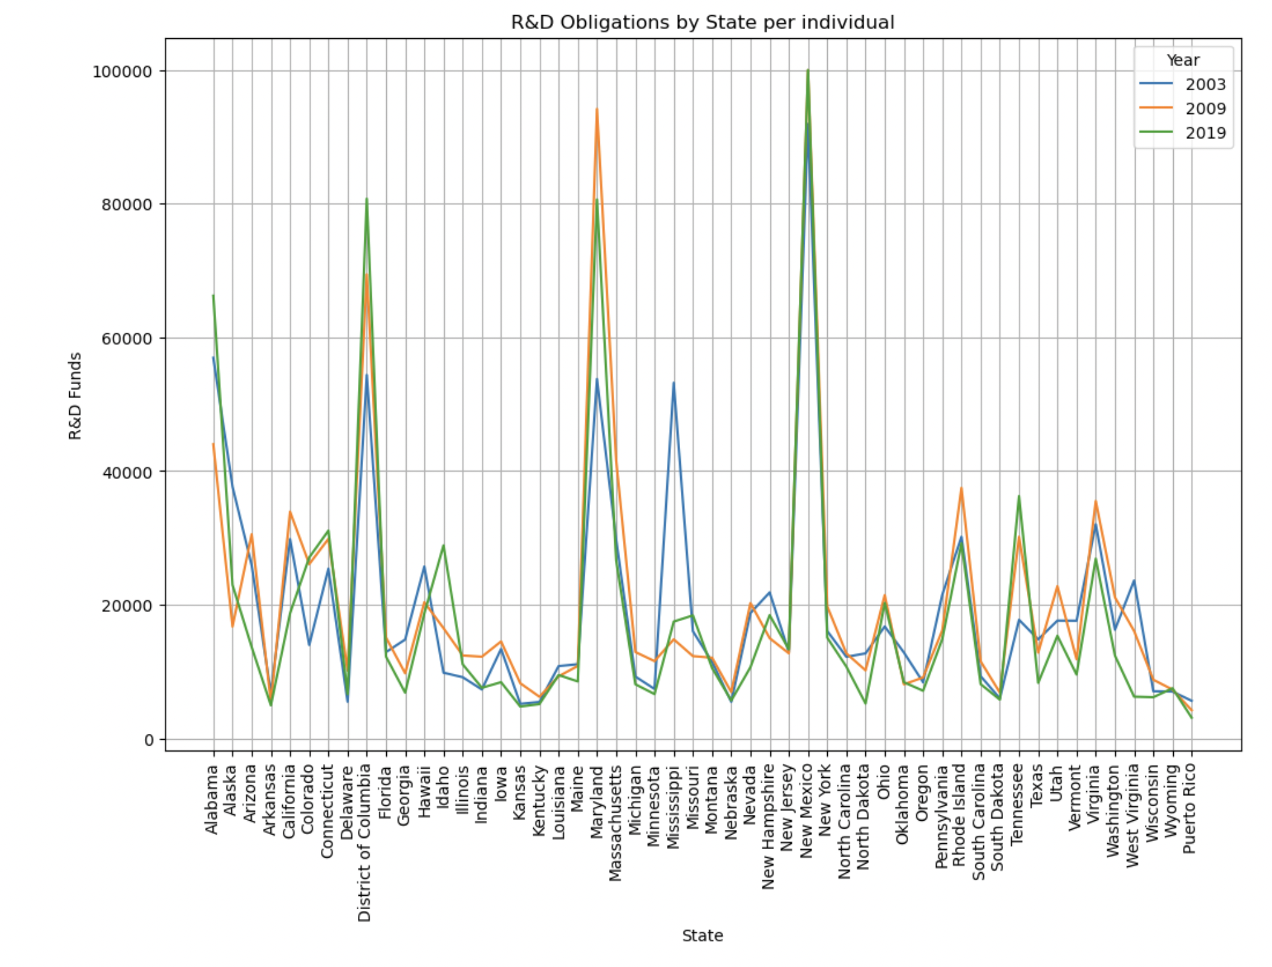
Did you know?
- New Mexico: Nuclear Laboratory
-Maryland: NIH
- DC and Alabama
-Show high Federal R&D Funds Obligation per person in Science and Engineering field
- 2003-2019 (Begin&End)| 2009(financial crisis )

Slide 8
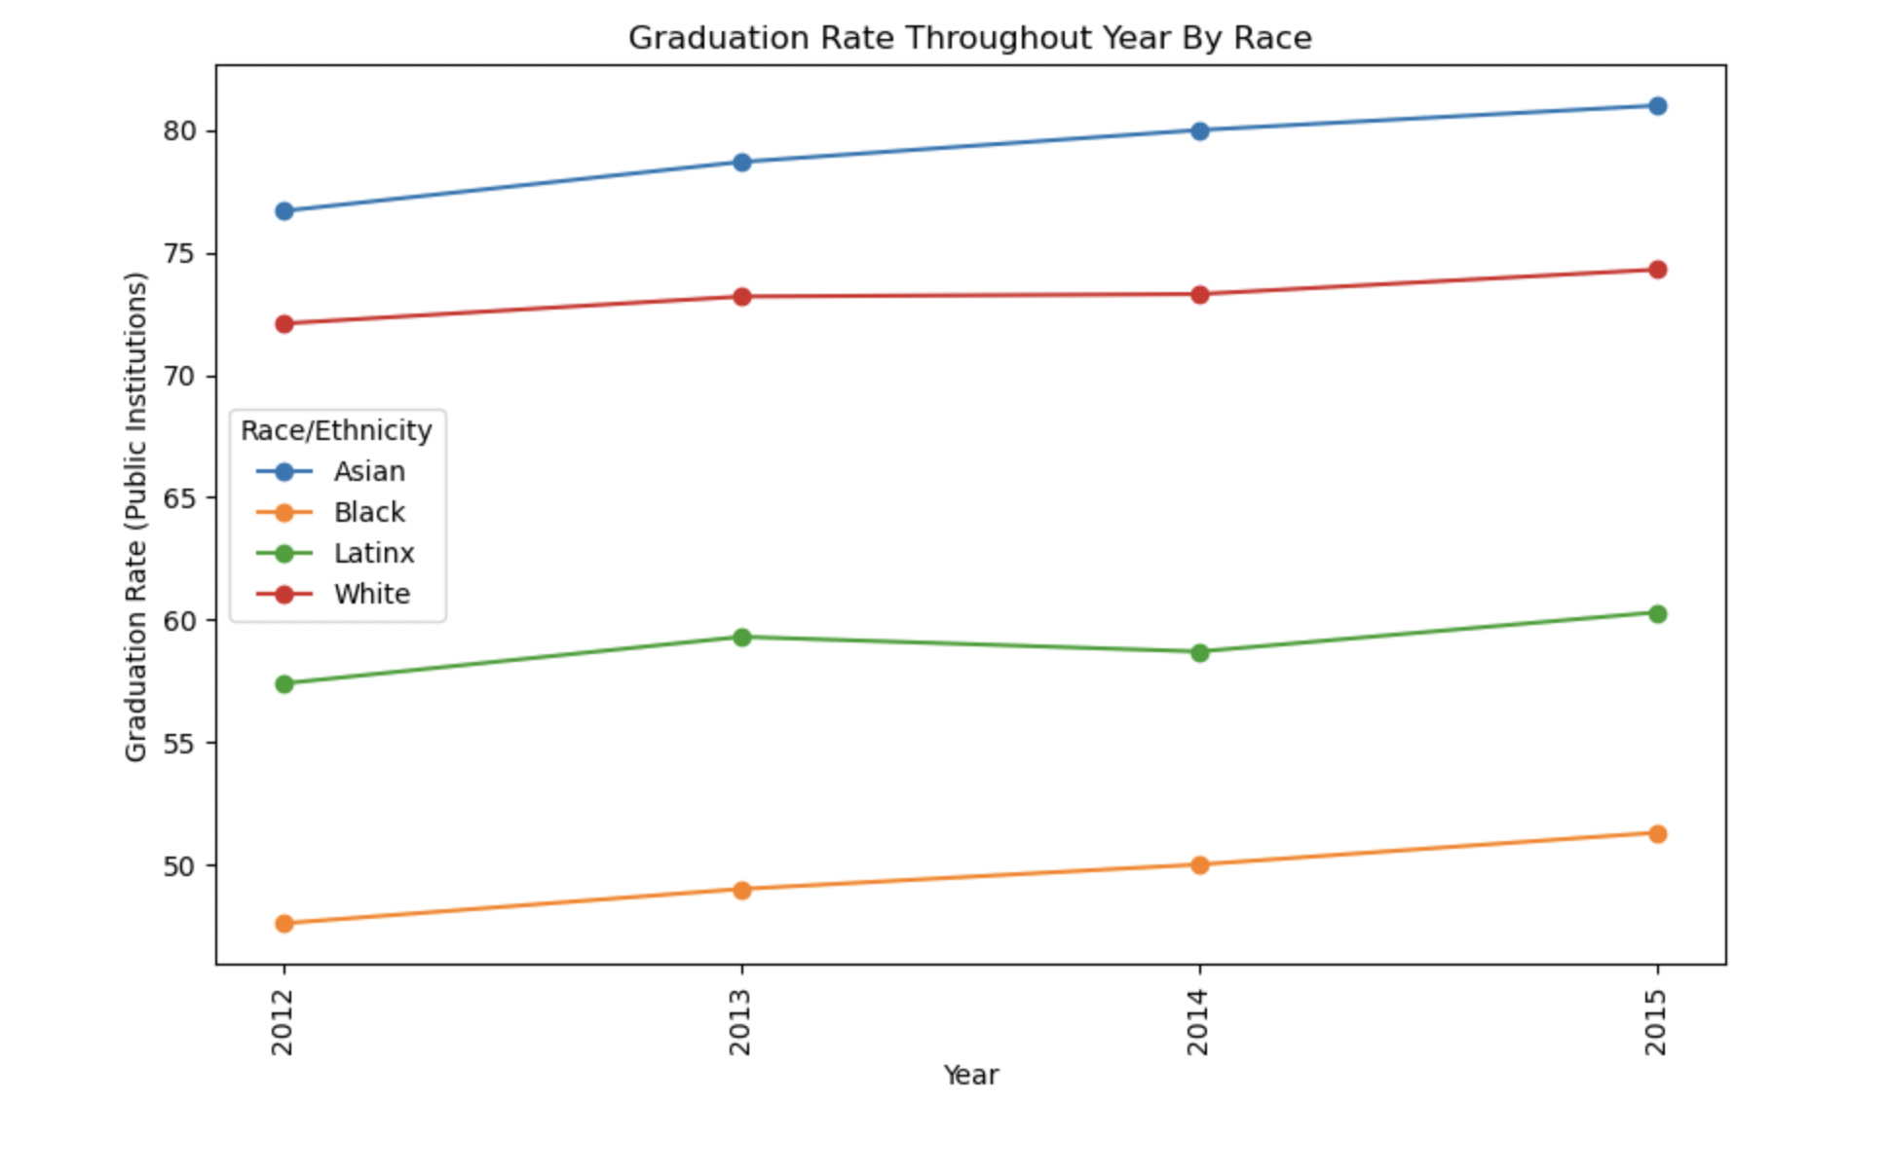
GradRate By Race
- Asians have higher graduation rate comparatively.
- We looked at public institutions.
-Further Questions: Could it be funding? Could it be that Asians get more honorary patent awards? Has it changed now?
-Know your data

Slide 9
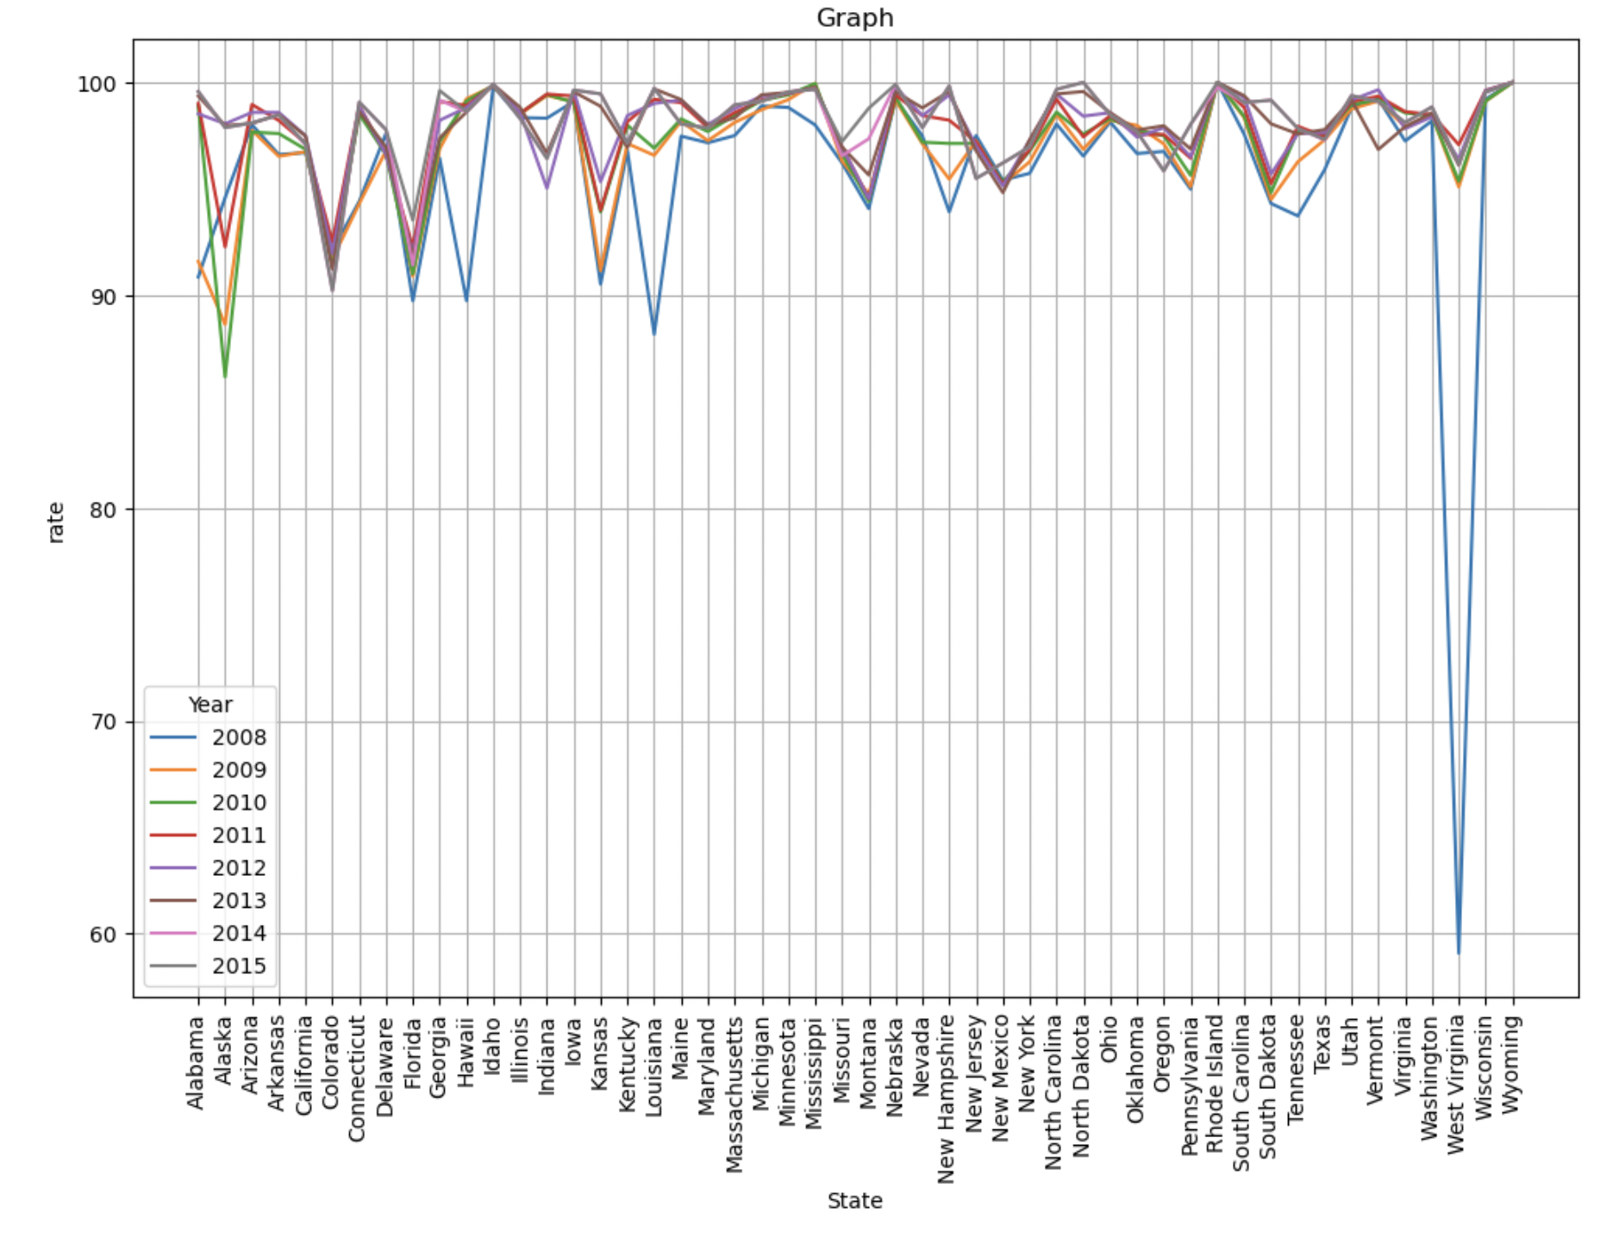
Skew?
-Visualizing every step to understand better.
- Graduation rate for West Virginia 2008 is below 60%.
-A major drop like don’t just happen.
- Could it be human error? Could it data error?
We are aware of what might affect our regression models.

Slide 10
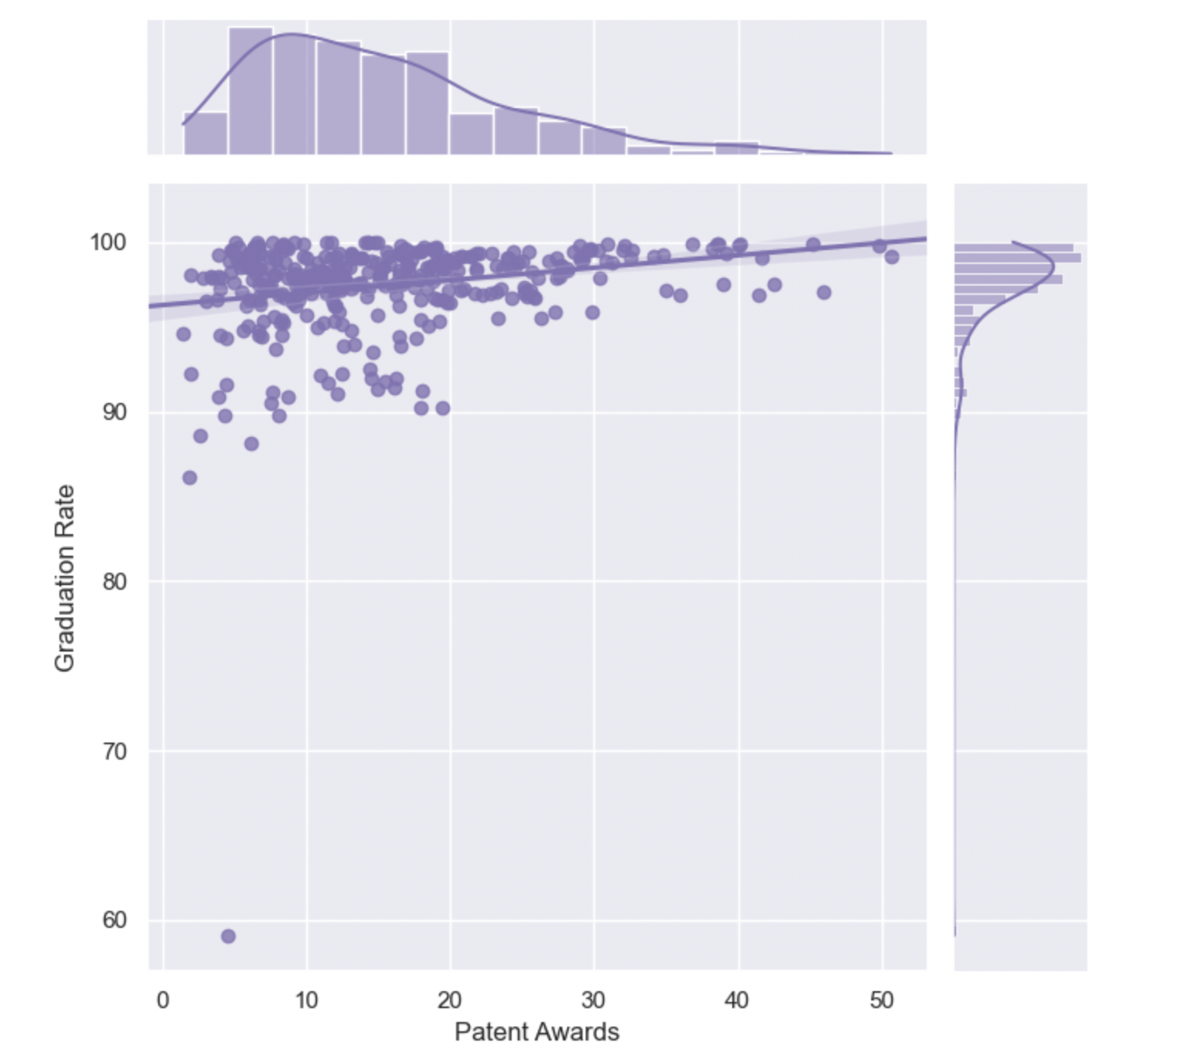
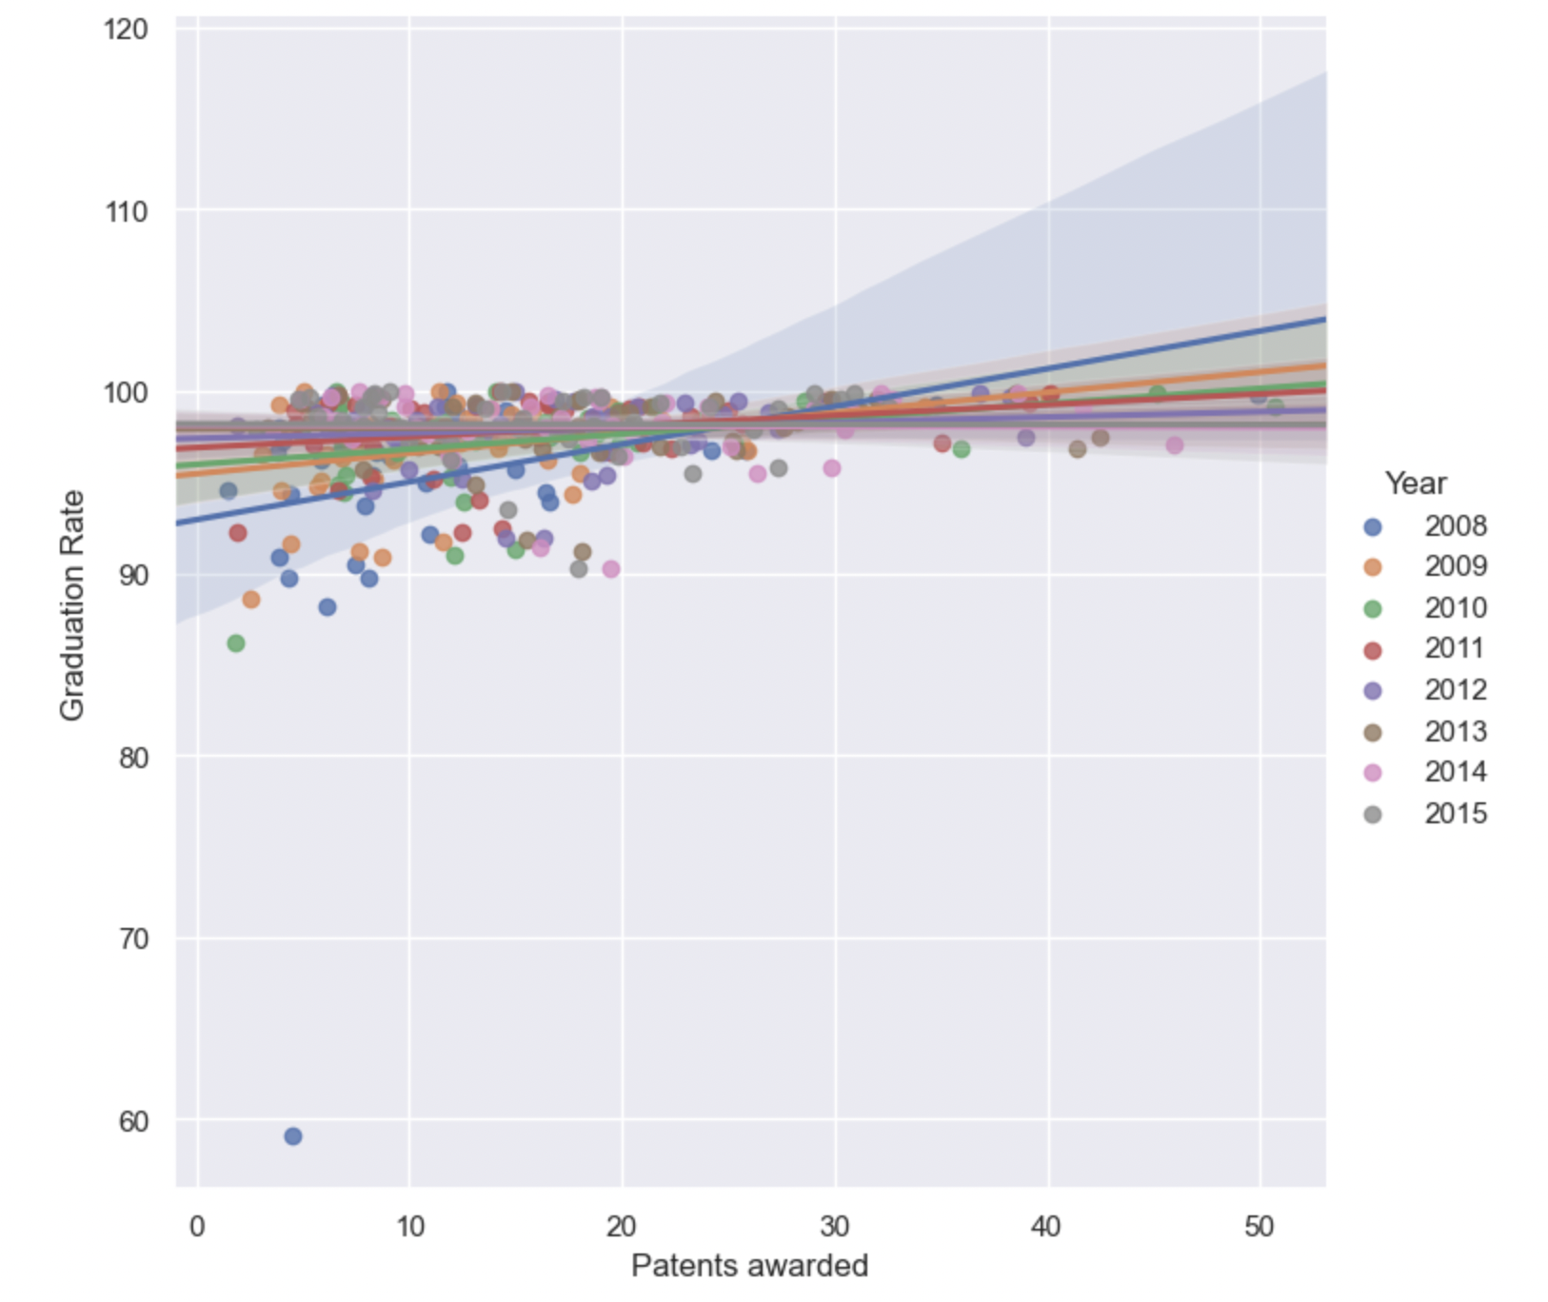
Linear Regressions (Seaborn PY)
To show the relationship between Patent awards per 1000 individual per state and graduation rates per state by different years

Slide 11
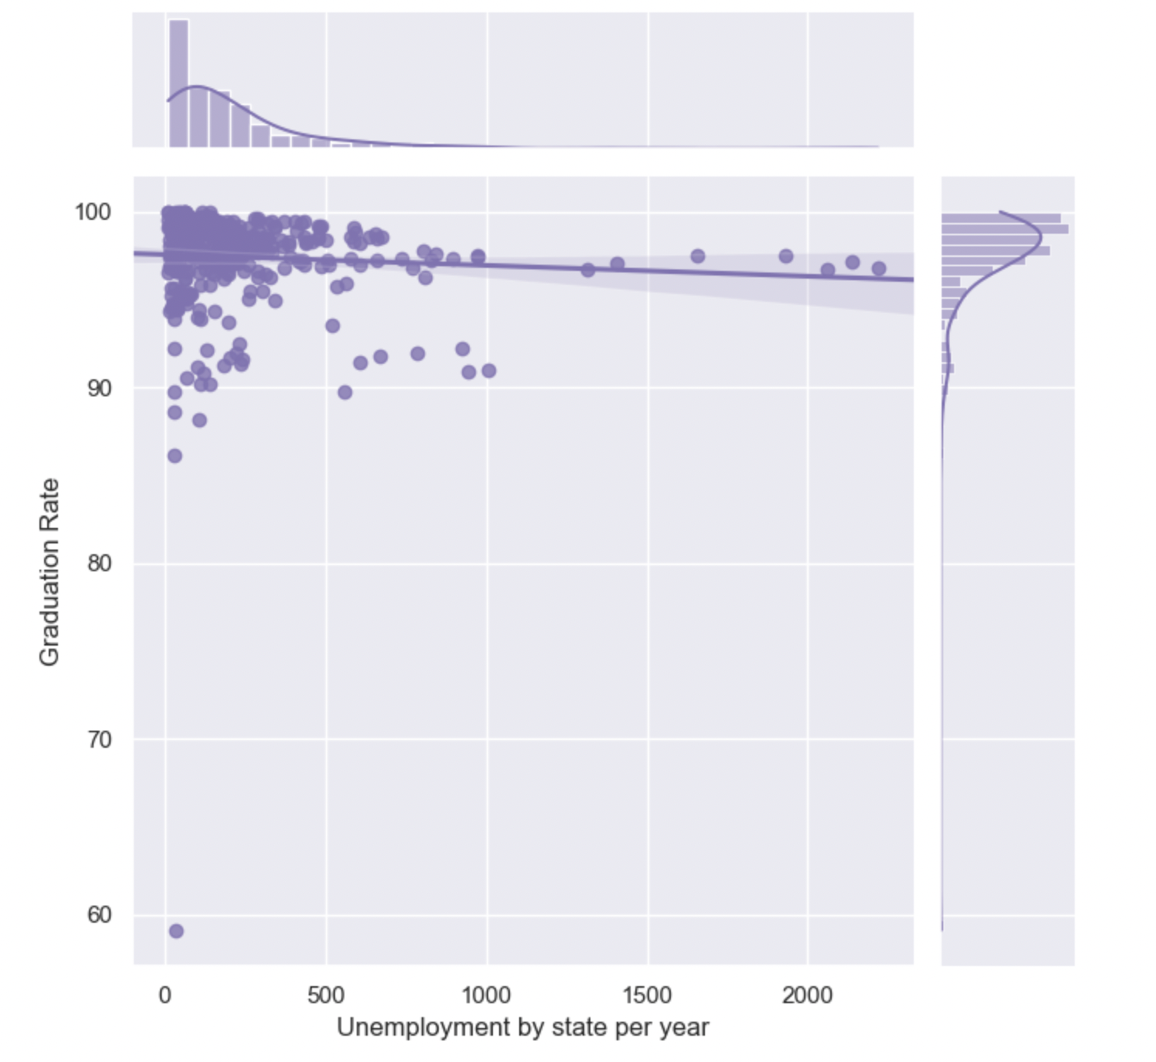
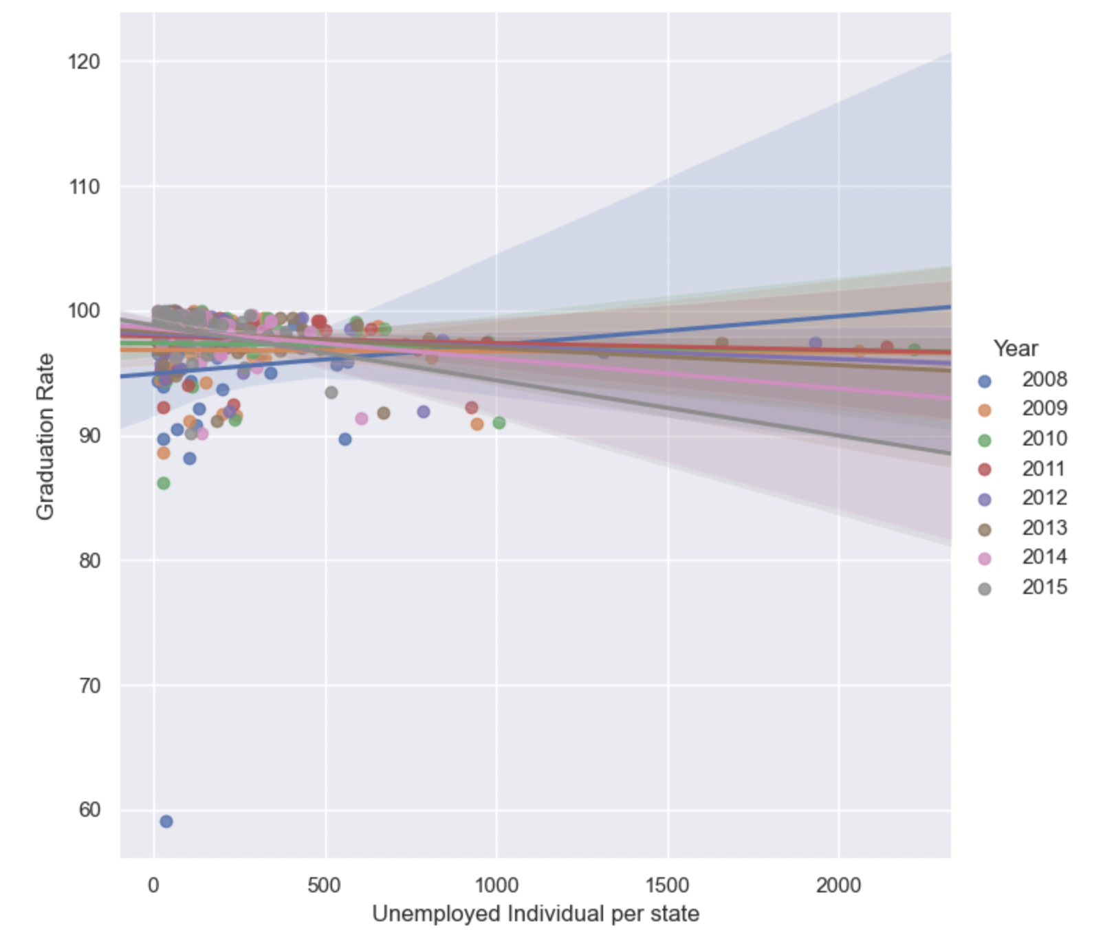
To show the relationship between Unemployed individuals in thousands per individual per state and graduation rates per state by different years

Slide 12
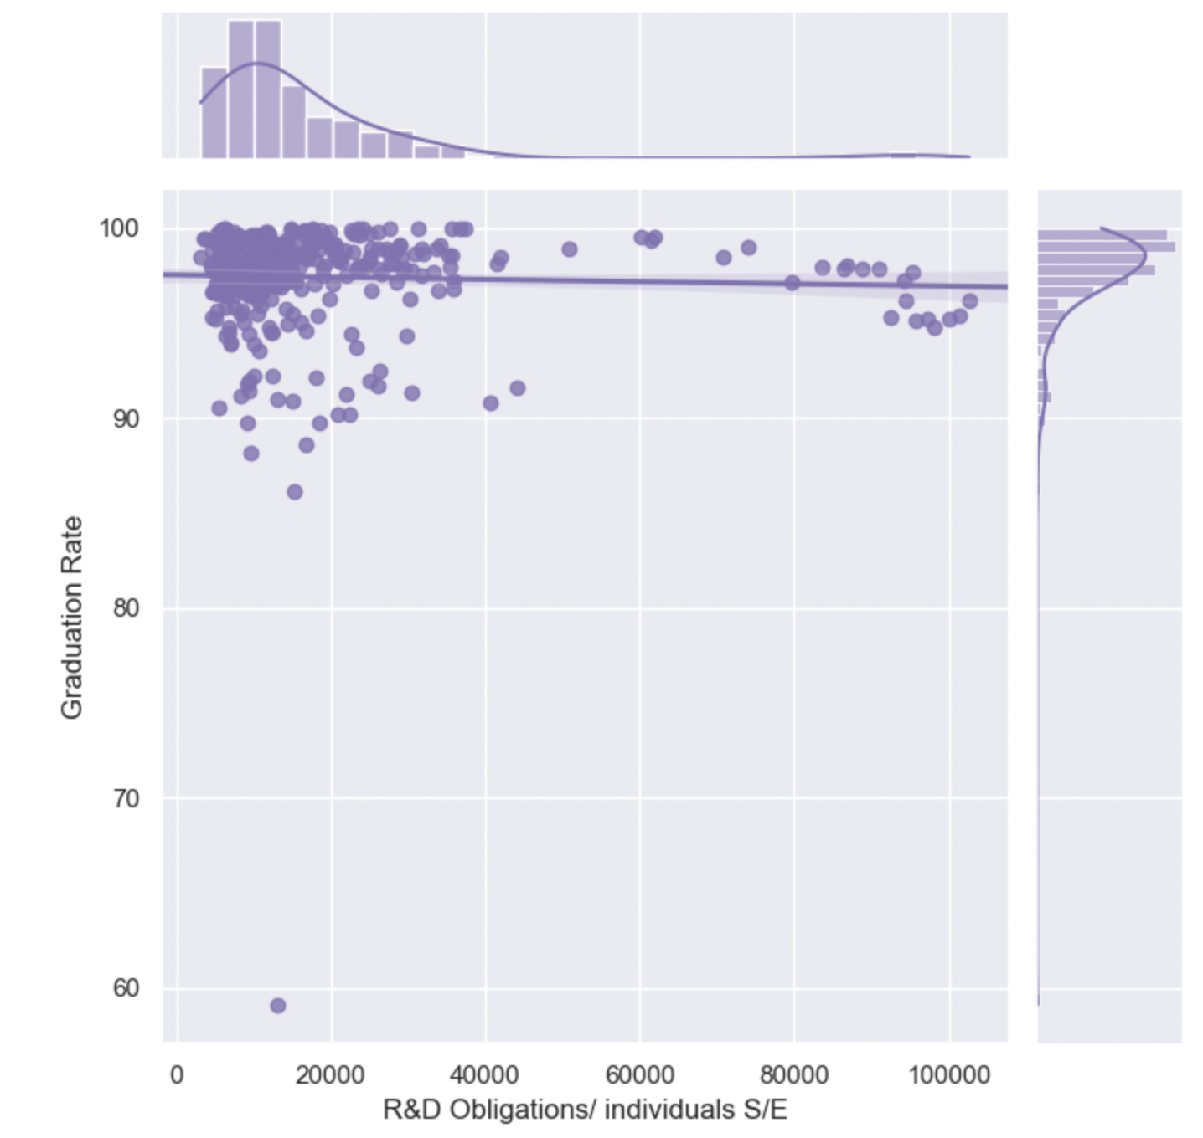
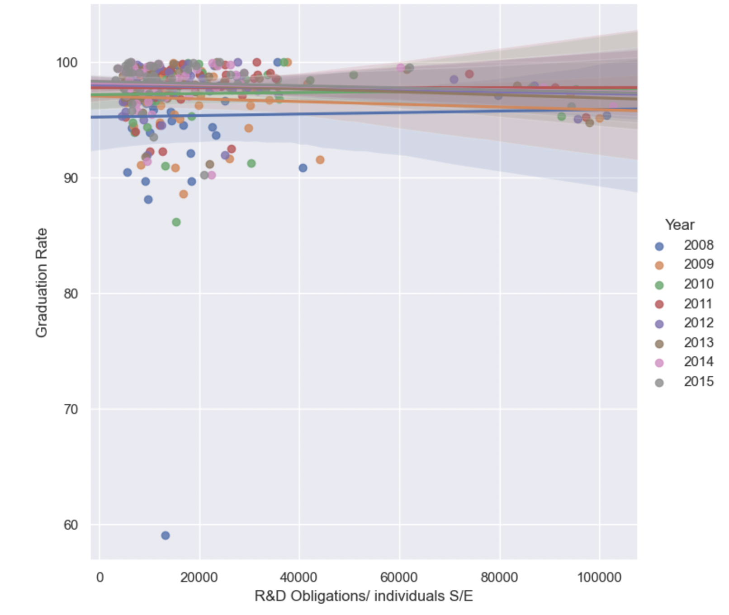
To show the relationship between Research & Development obligations per individual per state and graduation rates per state by different years

Slide 13
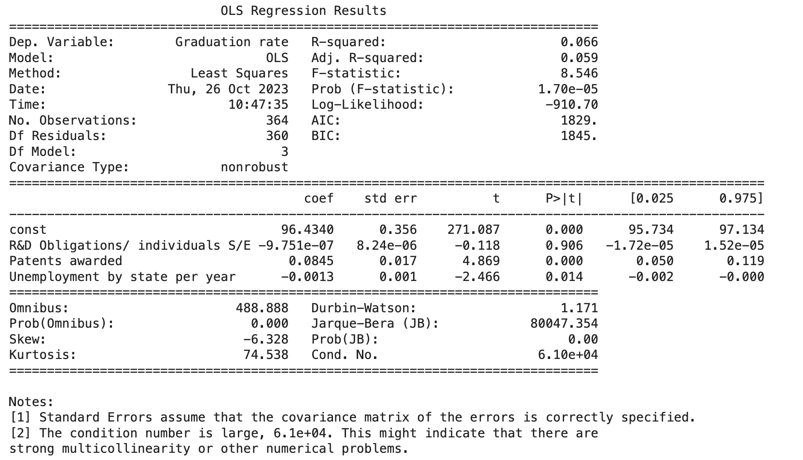
Multiple Linear Regression (MLR)
-Federal Funding is not statistically significant when relating to the effect it has on graduation rates.
-An increase of 1 patent award per 1000 people in S&E approximately increases the graduation rate by 0.0845%. This is statistically significant

Slide 14
Conclusion
Statistical significance was not seen for federal spending in Research and Development per individual in S/E in relation to having an effect on graduation rates.

Slide 15
Alternative Analysis
Investigating the effect of Research Related Variables on Employment Number

Slide 16
Data Analysis Method
Correlation Matrix: Finding Correlation Coefficient for each variable pair
We found that employment number has relatively high correlation with Research related variables
Variable Filter
For each employment number by race, the variables used are filtered based on correlation coefficient between the range of 0.7 to 0.9
Machine Learning
Model the changes in employment number by race from the filtered variables
Split training and test set by year
Test set is the last year available in the dataset
Regression Analysis
Investigation the relation found in the dataset

Slide 17
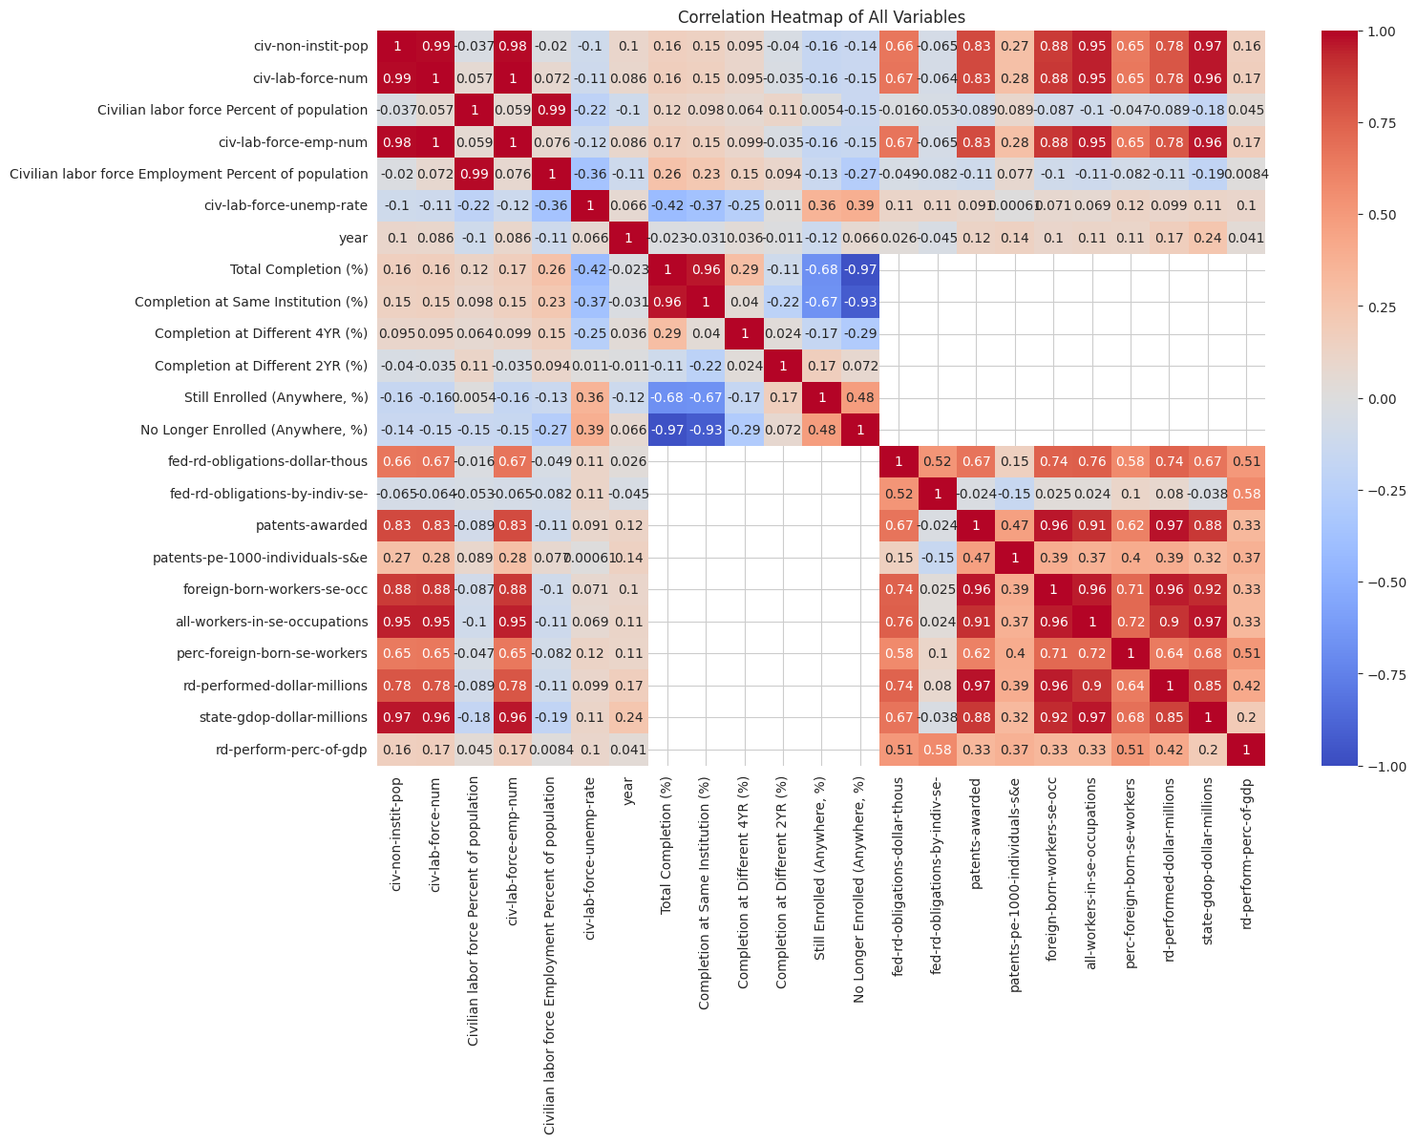
Dataset Correlation Matrix

Slide 18
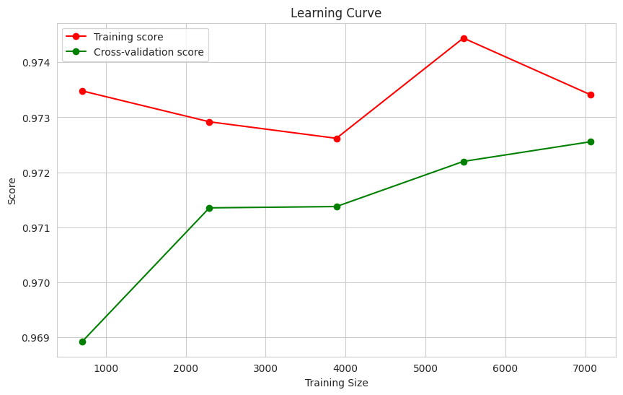
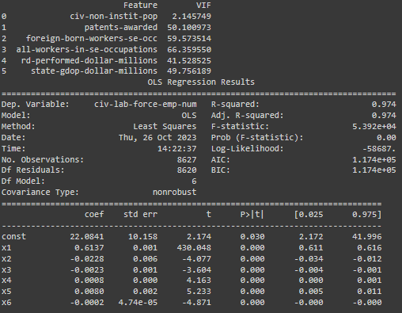
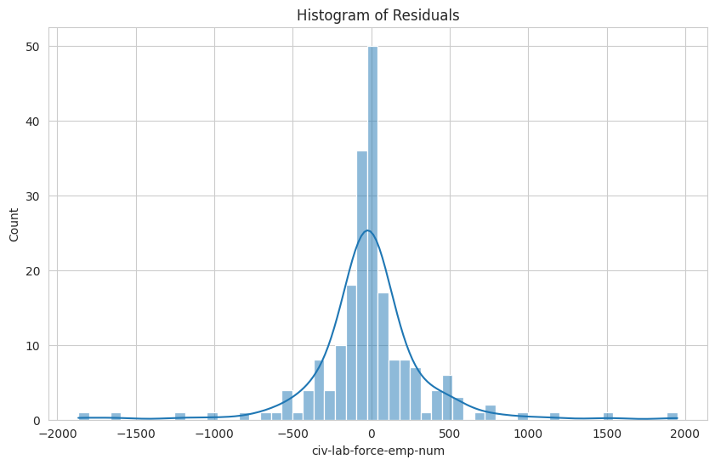
Data Analysis Output: White Employment

Slide 19
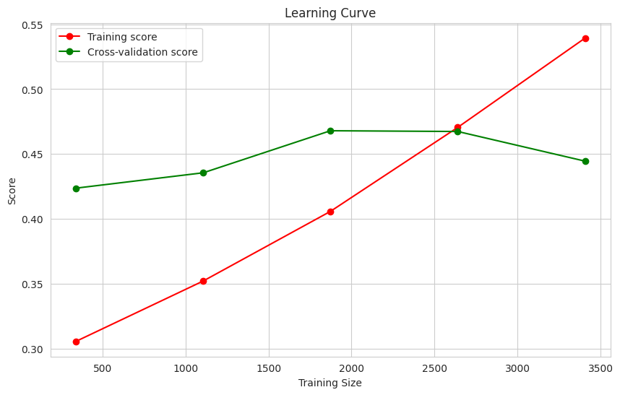
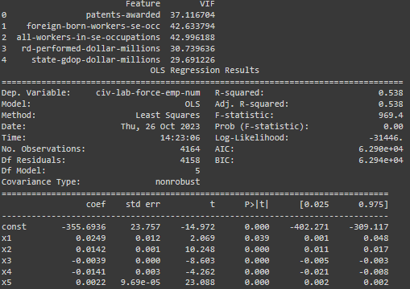
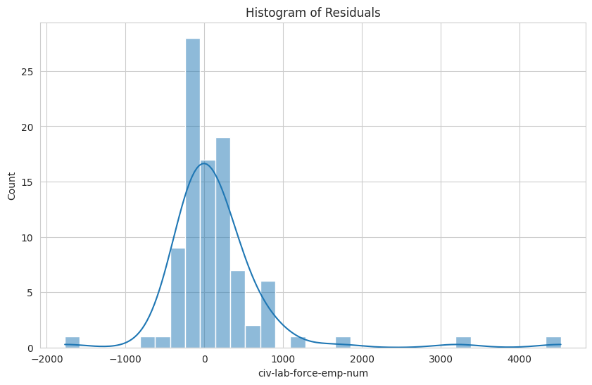
Data Analysis Output: Hispanic Employment

Slide 20
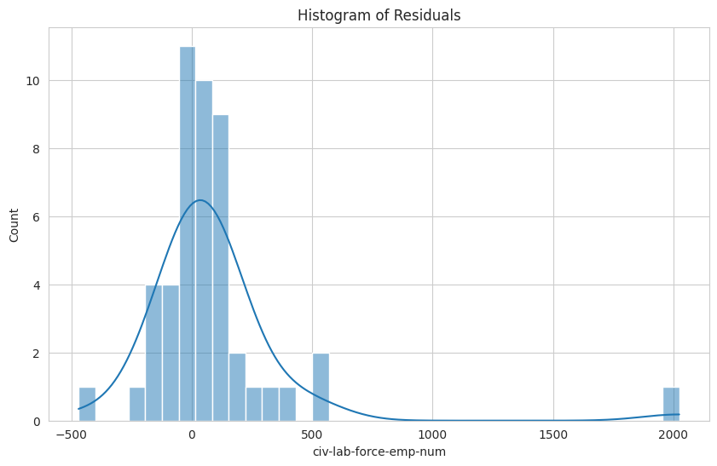
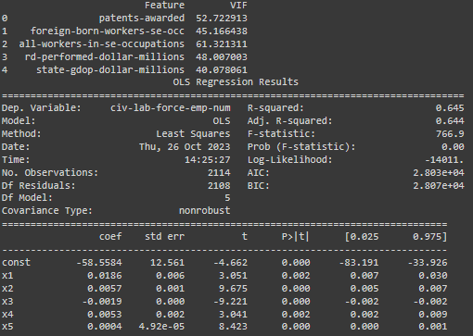
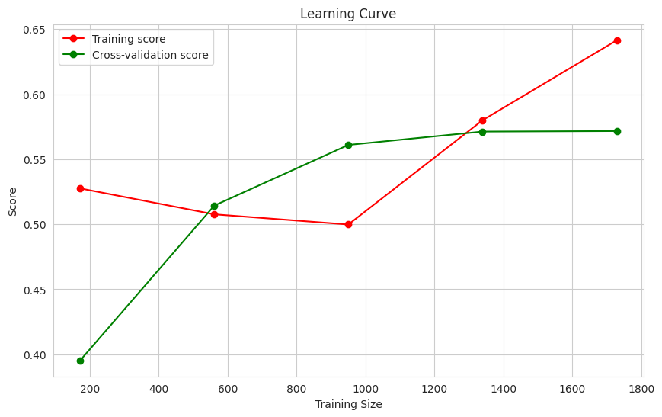
Data Analysis Output: Asian Employment

Slide 21
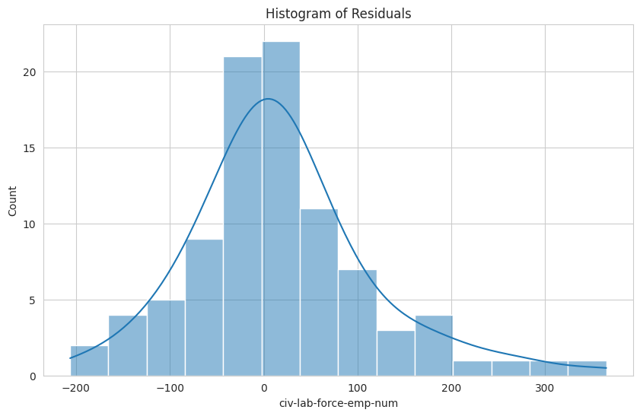
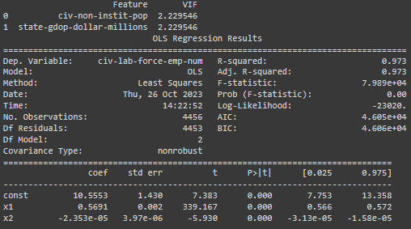
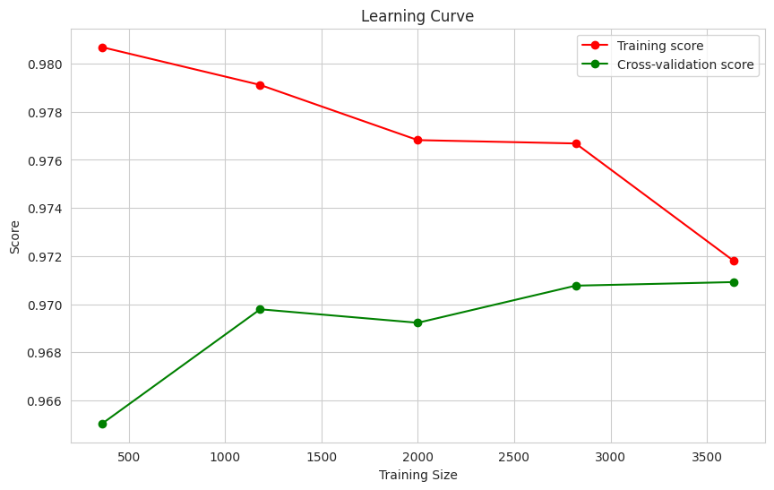
Data Analysis Output: Black Employment

Slide 22
Interpretation: Non-institutionalized Population
White | 6 White Employed for an increase of 10
Black | 5 Black Employed for 10
Hispanic | (Correlation less than 0.7)
Asian | (Correlation less than 0.7)

Slide 23
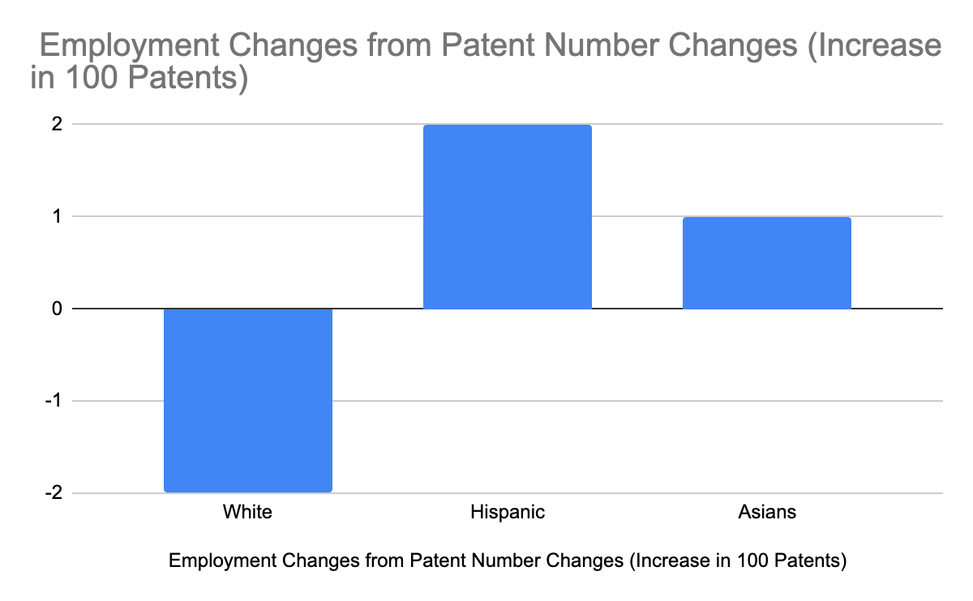
Interpretation: Patents
White | -2 White Employed for an increase of 100
Black | (Correlation less than 0.7)
Hispanic | 2 Hispanic Employed for 100
Asian | 10 Asian Employed for 100

Slide 24
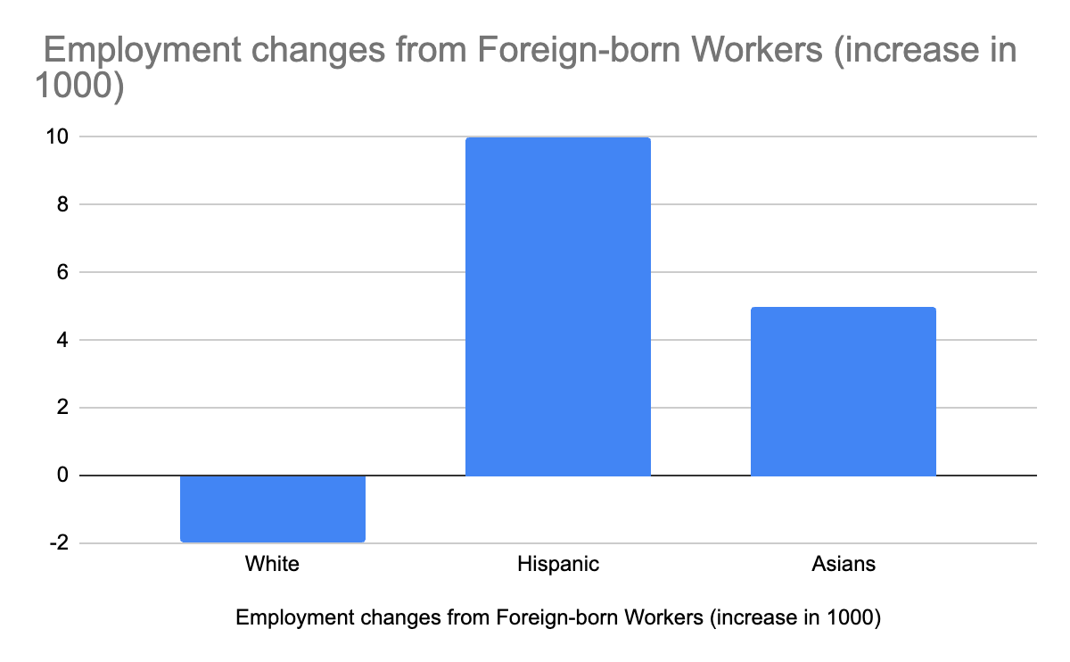
Interpretation: Foreign born workers
White | -2 White Employed for an increase of 1,000
Black | (Correlation less than 0.7)
Hispanic | 10 Hispanic Employed for 1000
Asian | 5 Asian Employed for 1,000

Slide 25
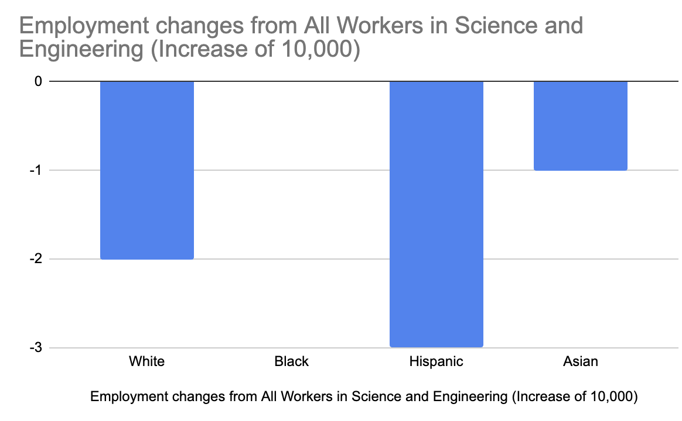
Interpretation: All Workers in S&E
White | -2 White Employed for an increase of 1,000
Black | (Correlation less than 0.7)
Hispanic | -3 Hispanic Employed for 1,000
Asian | -1 Asian Employed for 1,000

Slide 26
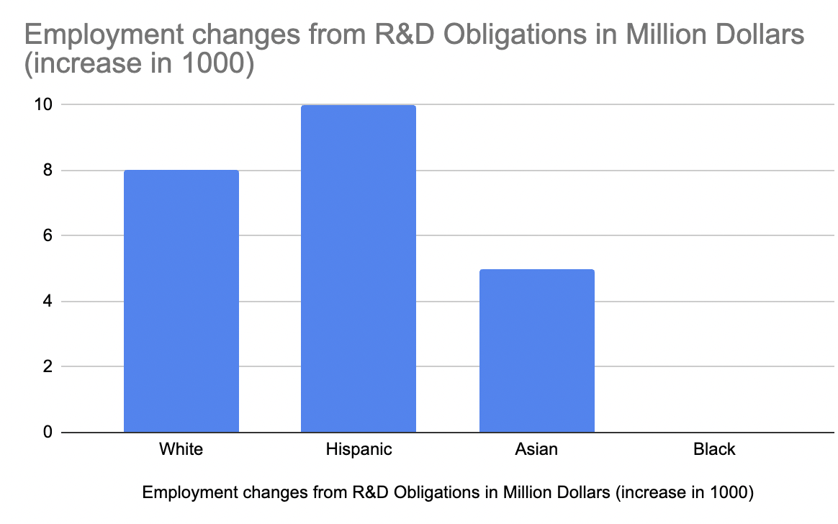
Interpretation: R&D Obligations in Million Dollars
White | 8 White Employed for an increase of 1,000
Black | (Correlation less than 0.7)
Hispanic | 10 Hispanic Employed for 1000
Asian | 5 Asian Employed for 1,000

Slide 27
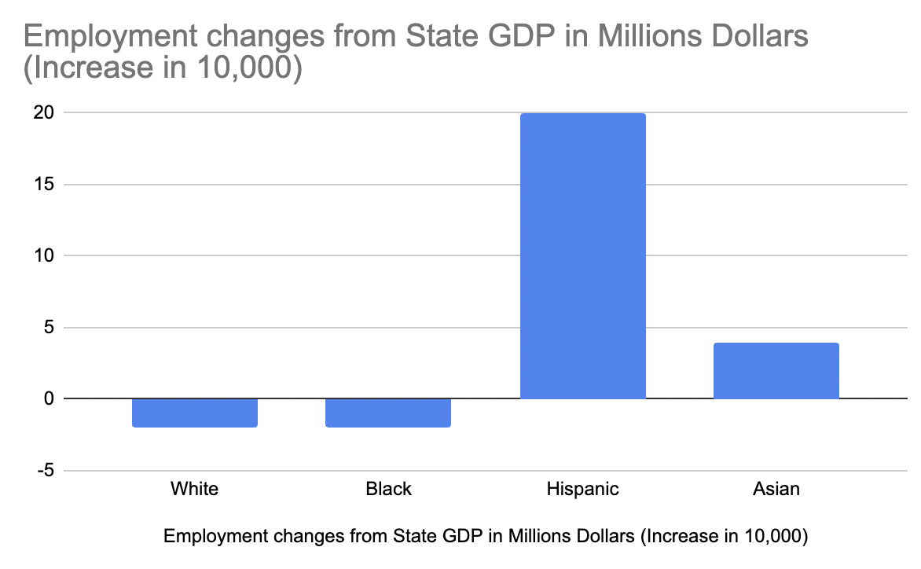
Interpretation: State GDP in Million Dollars
White | -2 White Employed for an increase of 10,000
Black | -2 Black Employed for 10,000
Hispanic | 20 Hispanic Employed for 10,000
Asian | 4 Asian Employed for 10,000

Slide 28
Conclusion
Opposite trend between Whites and minorities in patents awarded.
No statistical significance between R&D funds and graduation rate for general data without considering races.

Slide 29
Thank You!
Any questions?

Slide 30
Interpretation: Hispanic Employment Number (National Analysis)
Patents Awarded | 2 Hispanic Employed for 100
Foreign Born Workers in Science and Engineering | 1 Hispanic Employed for 100
All Workers in Science and Engineering | -3 Hispanic Employed for 1,000
R&D Obligations in Million Dollars | 1 Hispanic Employed for 100
State GDP in Million Dollars | 2 Hispanic Employed for 1,000
Adjusted R-squared: 0.53

Slide 31
Interpretation: Asian Employment Number (National Analysis)
Patents Awarded | 1 Asian Employed for 10
Foreign Born Workers in Science and Engineering | 5 Asian Employed for 1,000
All Workers in Science and Engineering | -1 Asian Employed for 1,000
R&D Performed in Million Dollars | 5 Asian Employed for 1,000
State GDP in Million Dollars | 4 Asian Employed for 10,000
Adjusted R-squared: 0.64

Slide 32
Interpretation: White Employment Number (National Analysis)
Non-institutionalized Population Number | 6 White Employed for an increase of 10
Patents Awarded | -2 White Employed for an increase of 100
Foreign Born Workers in S&E | -2 White Employed for an increase of 1,000
All Workers in S&E | 8 White Employed for an increase of 10,000
R&D Performed in Million Dollars | 8 White Employed for an increase of 1,000
State GDP in Million Dollars | -2 White Employed for an increase of 10,000
Adjusted R-squared: 0.974
S&E = Science and Engineering

Slide 33
Interpretation: Black Employment Number (National Analysis)
Non-institutionalized Population Number | 5 Black Employed for 10
State GDP in Million Dollars | -2 Black Employed for 10,000
Adjusted R-squared: 0.974

